Slide 1
19ECE301 Control Theory

Slide 2
Lesson overview
Course Information
Course Outcomes
Syllabus Overview
Course Plan
Textbook
Evaluation

Slide 3
Course Information
Course Title: Control Theory
Course Code: 19ECE301
Course Credits: 3-1-0-4 (Credits)
Course instructor: Mr. Venkata Sunilnag

Slide 4
Course Outcomes
Control systems consists of sub-systems assembled for the purpose of obtaining desired output with desired performance when given a specified input.
We can control some things only when we know how it behaves—Modelling
Desired Performance quantification – Analysis
Achieving Desired performance – Design

Slide 5
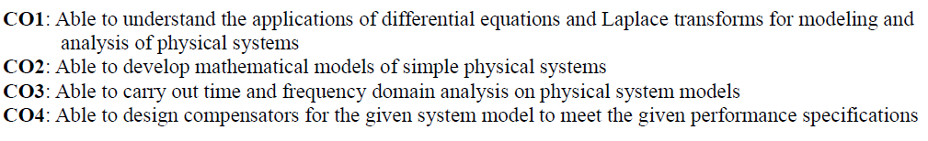
Course Outcomes

Slide 6
Syllabus overview

Slide 7
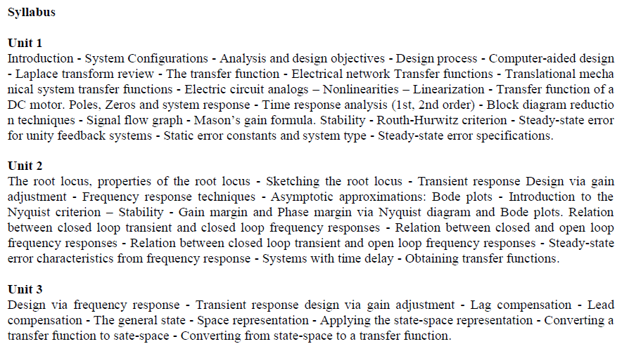

Slide 8
Course Plan (tentative)
S.No. | L. Nos. | Topic | Keywords | Objectives | Remarks | Course Outcomes
1 | 1 to 6 | Introduction to control systems, System configurations, design process, Computer aided Design | Open loop, closed loop systems | To introduce basic concepts of control systems | chapter 1 | CO1
2 | 7 to 11 | Laplace transform review - The transfer function, Electrical network Transfer functions (by inspection only and Cramers rule, no KCL or KVL ), Translational mechanical system transfer functions | Mass spring damper, RLC circuit | Introduction to Mathematical modeling with examples, Concept of transfer function | Sections 2.1 to 2.5 | CO1, CO2
3 | 12 to 16 | Poles Zeros and system response, Time response analysis (1st, 2nd order), System response with additional poles, System response with zeros. (no proofs) | Time constant, Rise time, peak time and other parameters, 1st, 2nd order systems | To impart understanding of the time domain Analysis | Sections 4.1 to 4.8 | CO1, CO3, CO4

Slide 9
Course Plan (tentative)
S.No. | L. Nos. | Topic | Keywords | Objectives | Remarks | Course Outcomes
4 | 17-23 | Reduction of multiple system, Block reduction techniques, Signal flow graph, Mason’s gain formula | Block diagram, signal flow graph, mason’s gain formula-(SISO systems only), | To reduce multiple sub- systems to a single block | Sections 5.1 to 5.5 | CO2
5 | 24 to 28 | Stability: Routh-Hurwitz criterion | Routh –Hurwitz criterion, absolute stability (Normal), 1st column zero, Row full zero | To understand stability Analysis of a given system | Sections 6.1 to 6.4 | CO1, CO3, CO4
6 | 29 to 31 | Steady-state error for unity feedback systems, Static error constants and system type, Steady-state error specifications. | Steady state error, system type, static error constants | To understand steady state performance Analysis of a given system | 7.1 to 7.4 and 7.6 | CO1, CO3, CO4

Slide 10
Course Plan (tentative)
S.No. | L. Nos. | Topic | Keywords | Objectives | Remarks | Course Outcomes
7 | 32 to 37 | The root locus, properties of the root locus, Sketching the root locus | Root locus | To understand root locus (only real poles, real poles and zeros, complex conjugate poles with and without zeros) | 8.1 to 8.7 | CO1, CO3, CO4
8 | 38 to 42 | Frequency response techniques. Asymptotic approximations: Bode plots | Frequency response, bode plot | To understand frequency response and its representation | 10.1 to 10.2 | CO1, CO2, CO4
9 | 43 to 48 | Introduction to the Nyquist criterion (no derivation) – Stability - Gain margin and Phase margin via Nyquist diagram and Bode plots | Nyquist plot, gain and phase margins | To understand the methods to determine stability and relative stability in frequency domain | 10.3 to 10.7 | CO1, CO3, CO4

Slide 11
Course Plan (tentative)
S.No. | L. Nos. | Topic | Keywords | Objectives | Remarks | Course Outcomes
10 | 49 to 51 | Steady-state error characteristics from frequency response, inverse bode plot | open loop frequency response, experimental determination of transfer function | to obtain specifications from open loop frequency response and use bode plot to obtain transfer function | 10.11,10.13 | CO1, CO3, CO4
11 | 52 to 56 | Design via frequency response - Transient response design via gain adjustment, Lead compensation | Phase lead compensator | To understand compensator design using bode plots | 11.1 to 11.4 | CO1,CO2,CO3,CO4
12 | 57 to 60 | The general state - Space representation, Applying the state-space representation | State variables, State space representation | To understand basics of state variable modeling | 3.1 to 3.4 | CO1,CO2

Slide 12
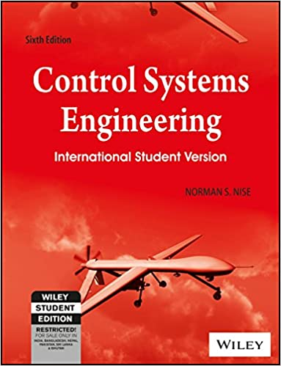
Textbook:
Norman Nise, “Control System Engineering”, John Wiley & Sons, Inc., Sixth Edition, 2011.

Slide 13
Evaluation
Continuous Assessment :
Quizzes in every class (40%)
Assignments (10%): 3, after each unit (handwritten/scanned and uploaded as pdf)
Term project (20%): 1, MATLAB based project in groups, report submission
Semester End Exam
Online Test (15%)
Viva (15%)

